Slide 1
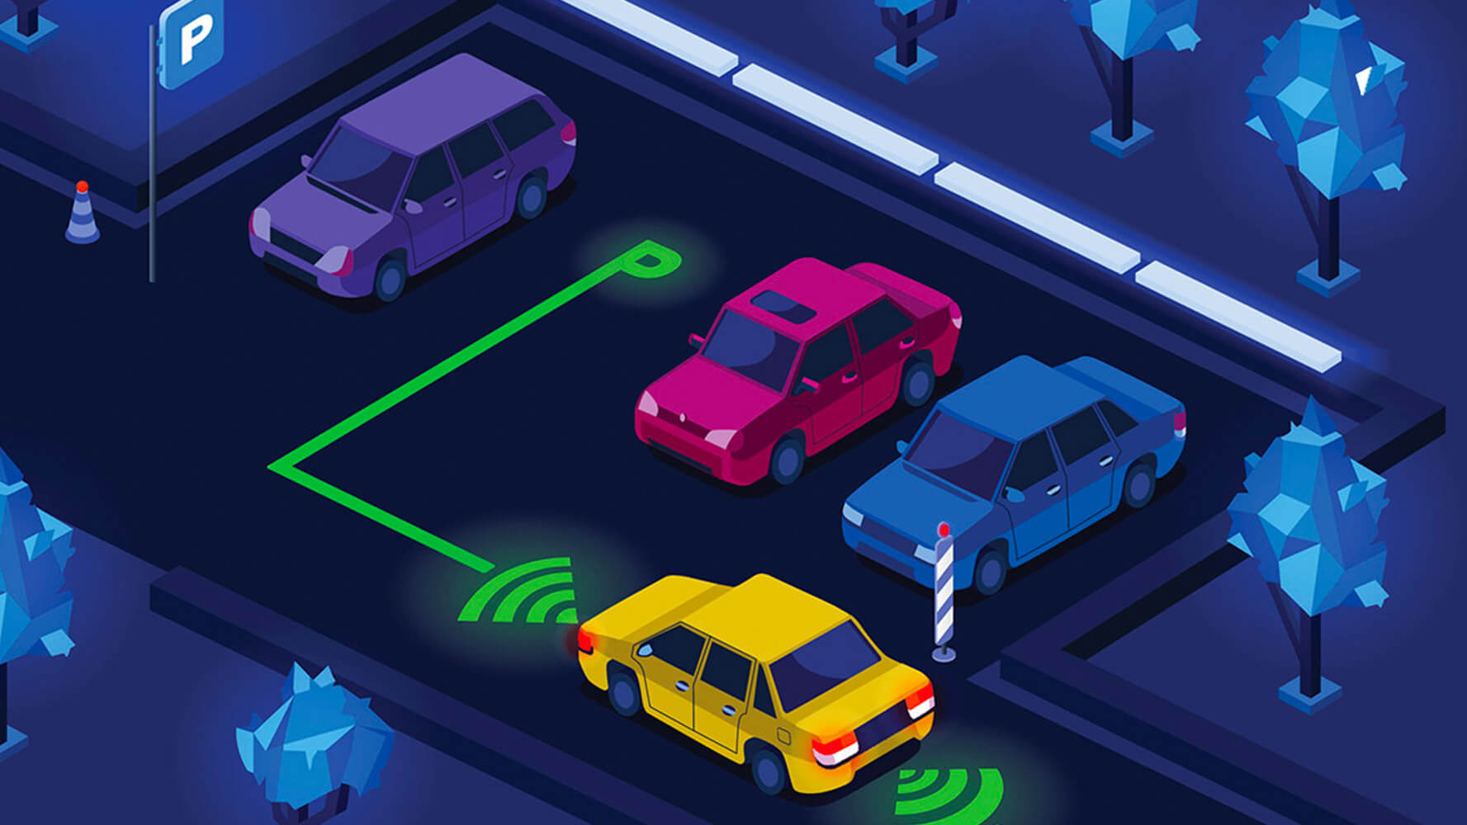

IOT
Smart Parking
Mohadese Ahmadi Dermani
Arshia Navab Akbar

Slide 2
Project Goal
To develop a state-of-the-art IoT-driven smart parking system that seamlessly combines vehicle detection, image capture, optical character recognition (OCR), and real-time data updates.
Project Goal

Slide 3

Raspberry pi
Ultrasonic Sensor HRC-04
IP Webcam, Webcam, RPi Camera (In the Node Red simulation project, photos are obtained through the internet rather than a camera.)
Sensors and edge devices to be used for data collection:

Slide 4

The software components responsible for data collection, storage, processing, dashboard visualization, and primary functionalities of each component are essential in data management:
Node-Red
JS
Firebase Realtime Database

Slide 5
Node-Red Palettes used :
Node-red-Contrib-firebase
Node-red-Contrib-Realtime-Database
Node-red-Contrib-image-output
Node-red-Contrib-plate-recognizer

Slide 6
Sensor Data Collection
Vehicle Presence Detection
Image Capture
Optical Character Recognition (OCR)
License Plate Database
Real-time Data Updates
User Interface Interaction
Status Display
Working Mechanism:
(Vehicle Detection)

